Slide 1


Real Time Shopping Mall Safety and Security System
Computing Department, FCIT
BSCS 8th semester
Group Members:
Hassan Afridi ( 1452-2020)
Mubashir Kamal Mallick ( 899-2020)
Muhammad Umar Hameed ( 1169-2020)
Supervisor Name :
Miss Erum Mumtaz
Co Supervisor Name: Sir Talha

Slide 2
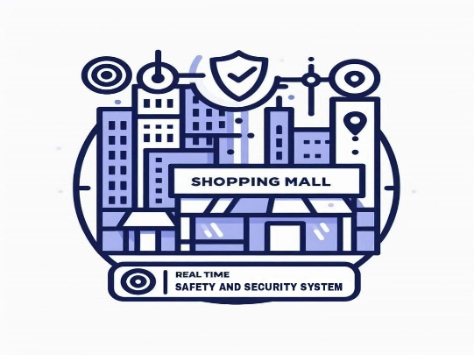

Introduction
In today’s rapidly evolving urban environments, shopping malls are not just retail hubs but also key social spaces that attract large numbers of people daily. Ensuring the safety and security of visitors and staff within these spaces is paramount. A robust real-time safety and security system can significantly enhance the overall experience by providing a secure and protected environment. This project aims to develop an advanced real-time safety and security system for shopping malls that leverages the latest technologies, including artificial intelligence (AI), Internet of Things (IoT), and data analytics, to ensure comprehensive surveillance, immediate response to emergencies, and efficient management of security protocols.

Slide 3

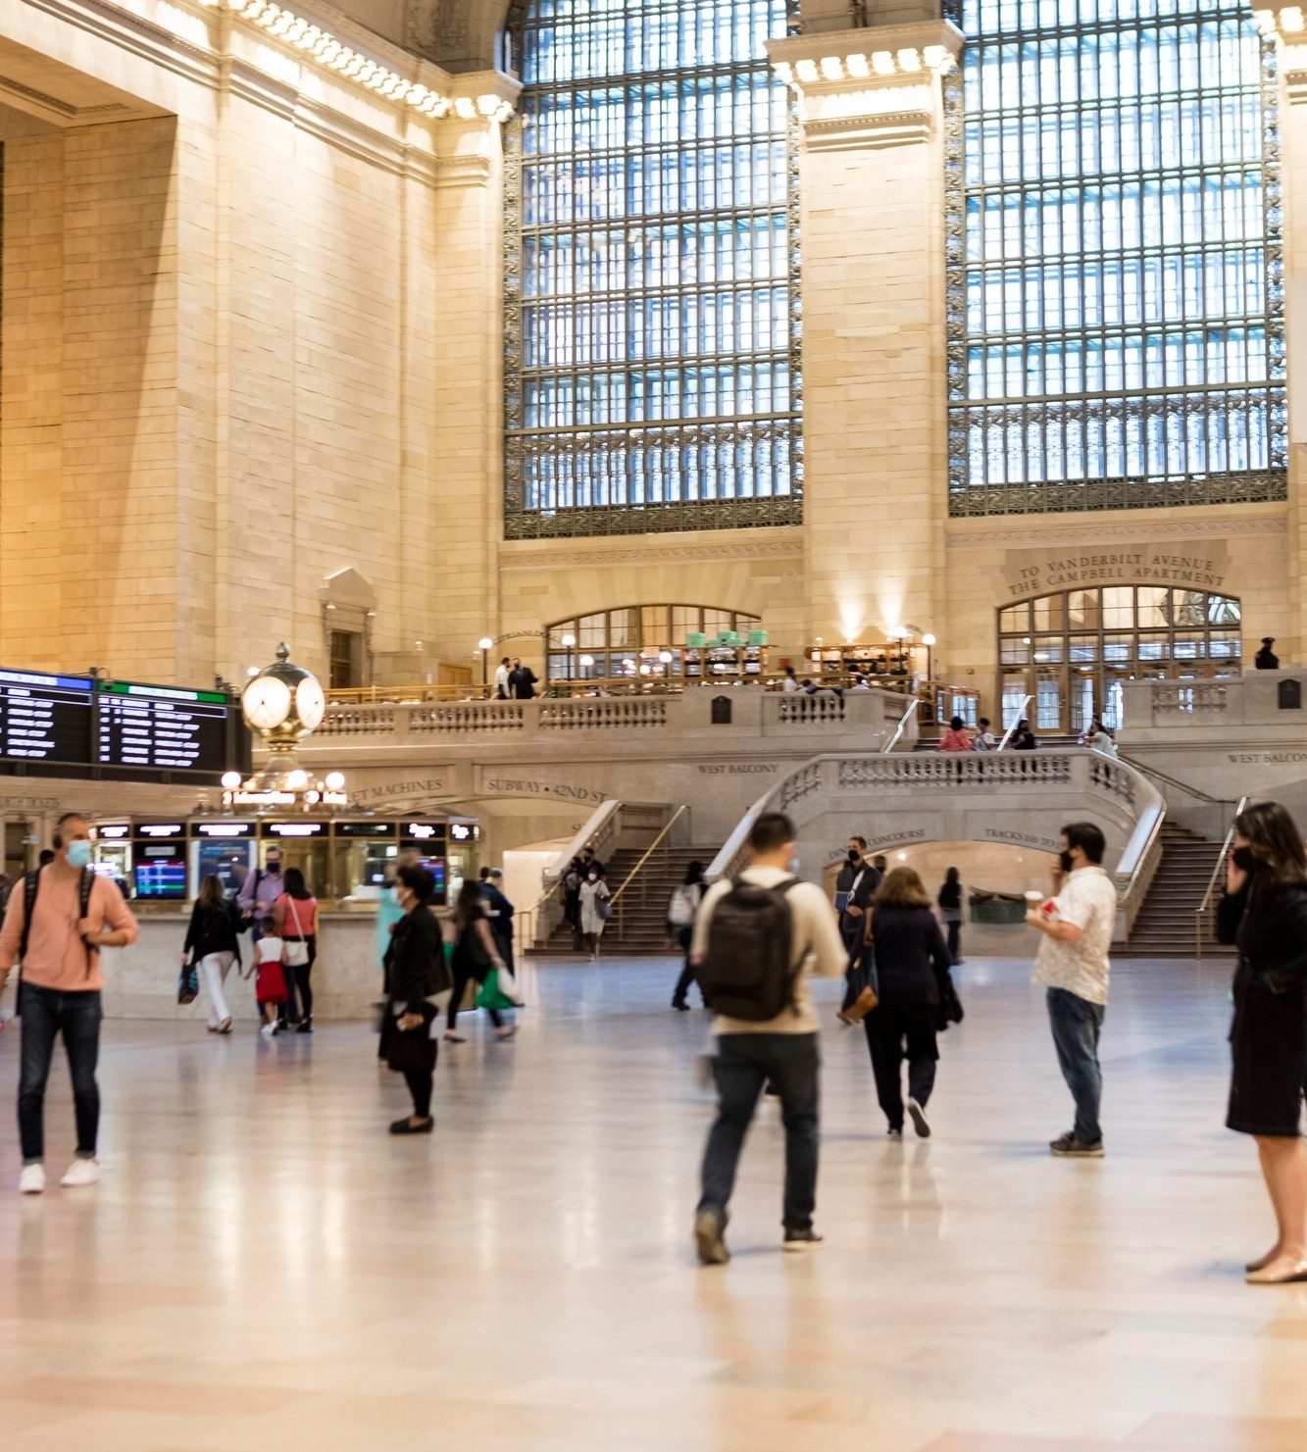
Problem Statement
Shopping malls face numerous safety and security challenges, including theft, vandalism, fire hazards, medical emergencies, and potential terrorist threats. Traditional security measures, such as static CCTV surveillance and manual monitoring, often fall short in providing real-time, proactive responses to these issues. There is a significant need for an integrated system that can offer real-time monitoring, automated threat detection, and swift emergency response to mitigate risks effectively. The primary problem this project addresses is the lack of a comprehensive, real-time safety and security system that can seamlessly integrate various technologies to enhance the security and safety of shopping mall environments.

Slide 4
Solution
Recent advancements in AI and IoT have revolutionized security systems. AI-powered surveillance cameras can now detect unusual activities and potential threats in real-time. Integrating various technologies into a unified system can significantly enhance the effectiveness of security measures. Several shopping malls worldwide have started implementing advanced security systems. Despite these advancements, there is still a lack of comprehensive systems that fully integrate all available technologies into a seamless security solution for shopping malls. Most existing systems focus on specific aspects of security, such as surveillance or environmental monitoring, rather than providing an all-encompassing solution. This project aims to bridge this gap by developing an integrated, real-time safety and security system tailored specifically for shopping malls.

Slide 5
Project Overview
The UI is a critical component of our project, designed to provide security personnel with intuitive and immediate access to vital information, enabling them to monitor and manage the mall's safety efficiently. Our user interface is crafted with the end-user in mind, focusing on usability, clarity, and responsiveness. It integrates multiple data sources, such as CCTV feeds, IoT sensor data, and emergency alerts, into a single, cohesive dashboard. This integration ensures that security staff can quickly assess and respond to any situation, enhancing overall safety and security.

Slide 6
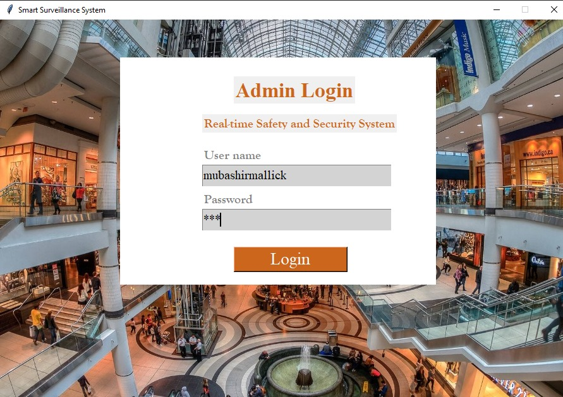
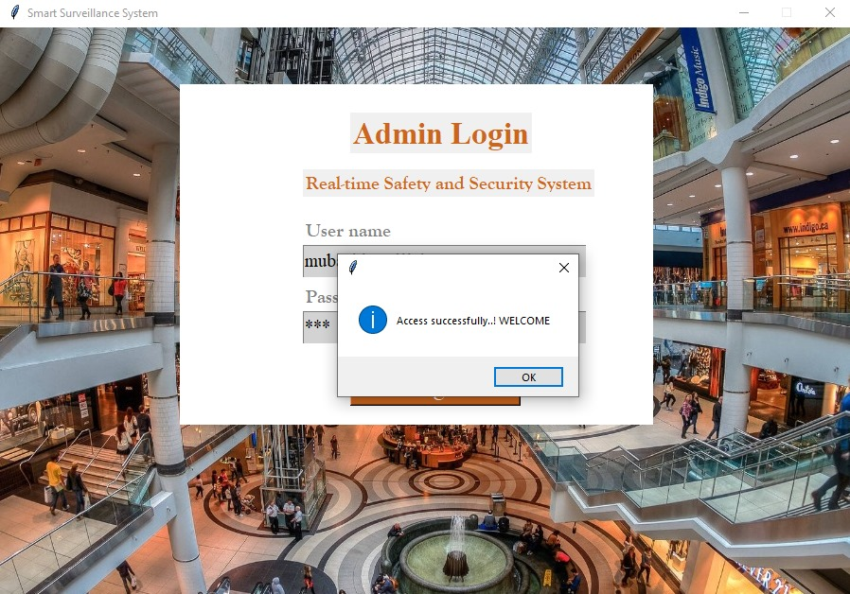
Project Overview

Slide 7
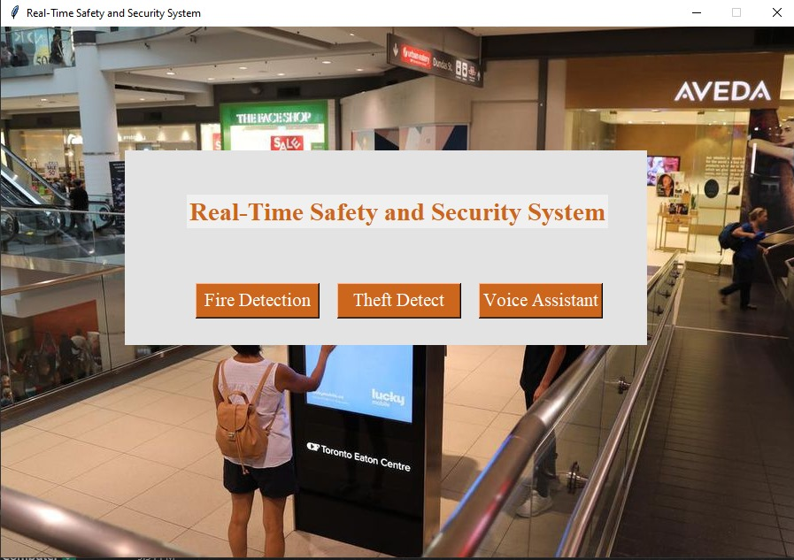
Project Overview

Slide 8
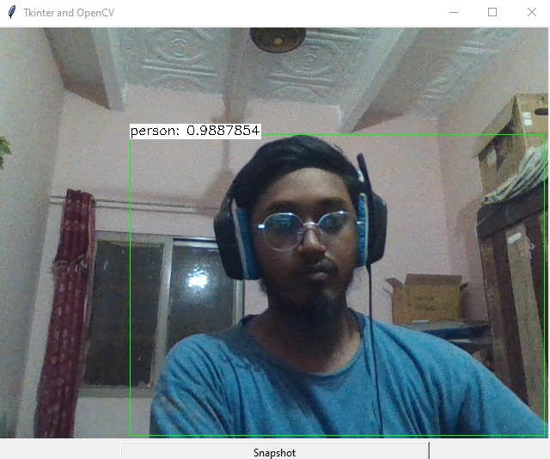
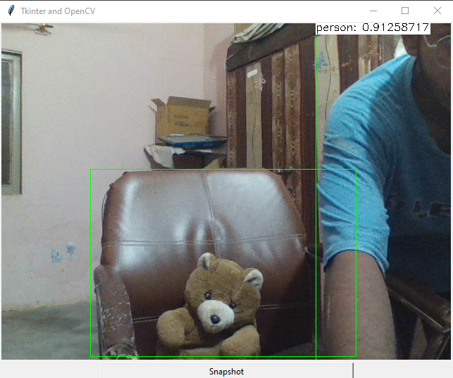
Project Overview
In our application, SSD plays a crucial role in detecting and monitoring various objects and events within the shopping mall environment. By leveraging deep convolutional neural networks (CNNs) and advanced bounding box regression techniques, SSD enables our system to identify potential security threats in real-time with high precision.

Slide 9
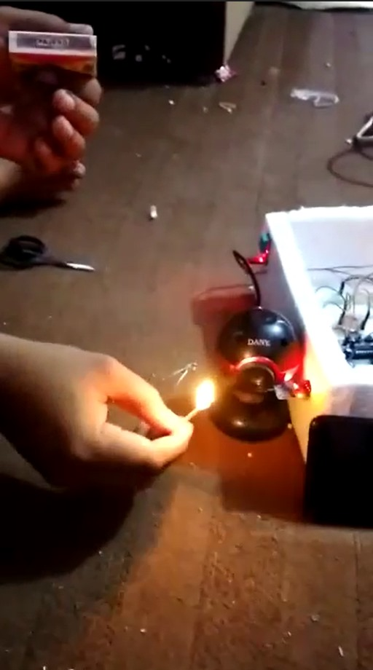
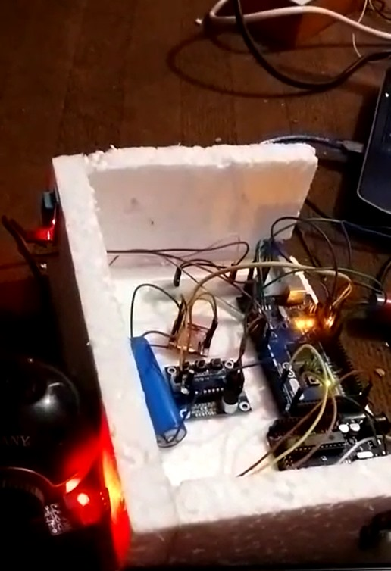
Project Overview
Our fire detection sensor employs cutting-edge technology to monitor environmental conditions and detect potential fire incidents promptly. Equipped with sensitive sensors and intelligent algorithms, it continuously scans the mall area to identify early signs of smoke or temperature anomalies associated with fires.

Slide 10


SDG’s
The system includes sensors for smoke and carbon monoxide detection, which can immediately alert authorities and initiate evacuation procedures, thus protecting individuals from health hazards. Real-time data allows for faster response to medical emergencies within the mall, ensuring timely medical intervention.
Uses cutting-edge technologies such as high-resolution cameras, RFID readers, and IoT devices to create a comprehensive security network. By continuously monitoring the mall environment and detecting potential threats early, the system contributes to the resilience and reliability of the mall's infrastructure.

Slide 11


SDG’s
Enhances the overall safety of public spaces, making shopping malls more secure for the public. Helps in creating emergency preparedness plans by providing valuable data and insights on safety protocols and potential risk areas within the mall.
The presence of a robust security system can act as a deterrent to criminal activities, ensuring a peaceful shopping environment. The system’s ability to record and store data can aid law enforcement in investigating incidents and ensuring justice.

Slide 12
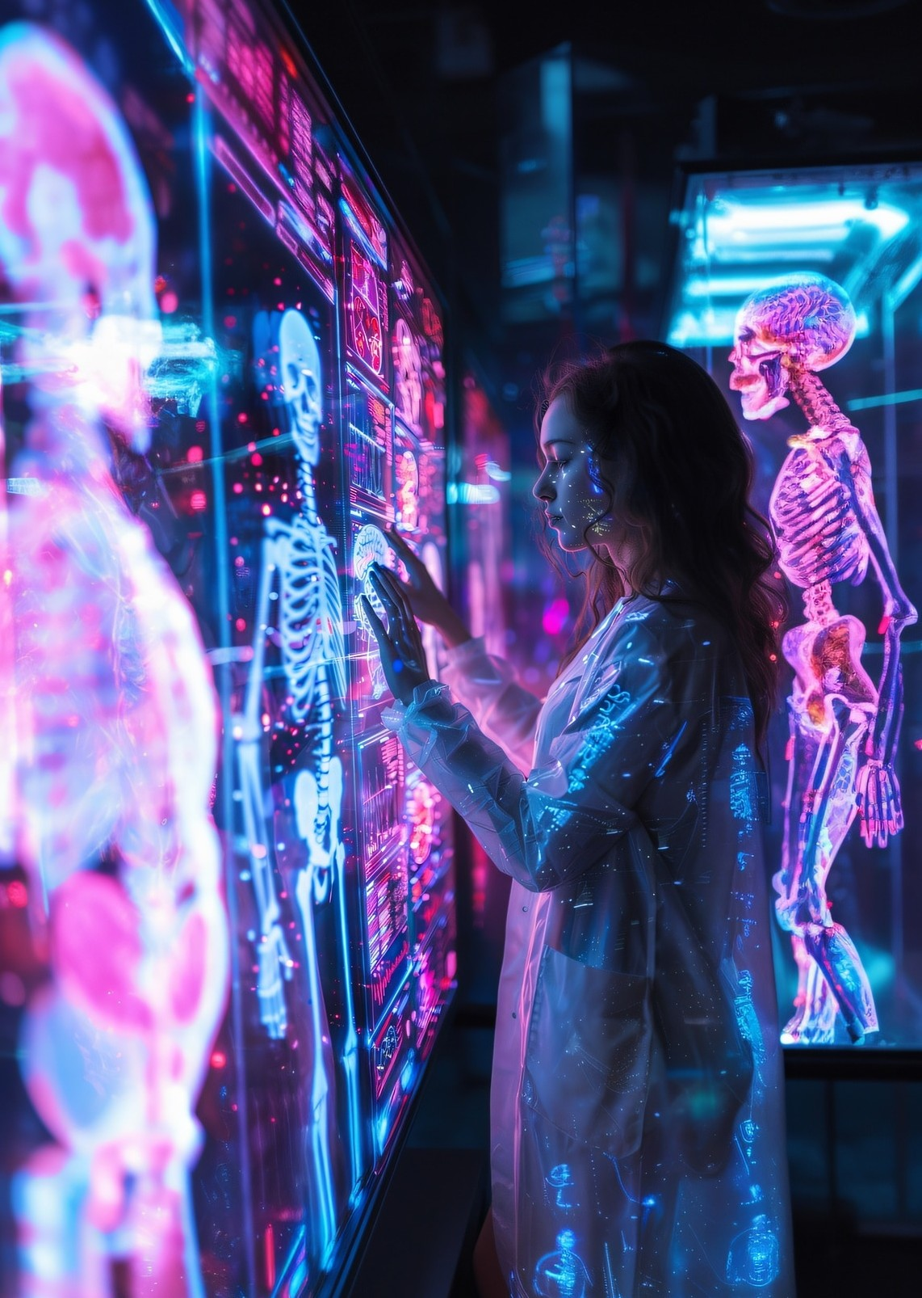


Future Work
1. Completion of System Development
Complete the integration of all subsystems (e.g., CCTV, IoT sensors, emergency response) into a cohesive real-time safety and security system. Improve the user interface for security personnel, ensuring it is intuitive and provides easy access to real-time data and alerts.
2. Testing and Validation
Conduct extensive simulation testing to ensure system reliability and responsiveness in various scenarios, including emergency situations like fires or medical emergencies. Perform real-world trials in collaboration with a local shopping mall to validate the system’s effectiveness and gather practical feedback for improvements.
3. Integration with Emergency Services
Establish direct communication links with local emergency services (e.g., police, fire department) for faster response times. Implement automated alert systems that can immediately notify emergency services in case of a critical incident.

Slide 13
CONCLUSION
Our project on developing a real-time safety and security system for shopping malls addresses a critical need in modern urban environments. By leveraging advanced technologies such as AI, IoT, and data analytics, we aim to create a comprehensive, proactive solution that enhances the safety and security of both visitors and staff.
Our work thus far has laid a strong foundation, from identifying the problem and reviewing relevant literature to implementing key components of the system. The preliminary results are promising, indicating that our system can significantly improve real-time monitoring and emergency response.
As we move forward, our focus will be on completing system integration, conducting thorough testing and validation, enhancing security measures, and optimizing performance. We also plan to expand the system's capabilities and ensure it is user-friendly and compliant with privacy regulations.

Slide 14


Thanks!
ANY QUESTIONS?

